Slide 1
Toddler
Safety
Notes:
When set up projector, instead of saying to duplicate it on other screen, choose extend. Then under slide show, click “Use Presenter View”

Slide 2
Topics We’ll Cover
Balancing Safety and Exploration
Safety-Proofing
Most Common Injuries for Children
  Preventing and Treating
Teaching Safe Behavior, Smart Choices
Allowing for Risk Taking
Notes:
VERY BRIEF! Move through quickly
Class introduction and overview:
There are many things you can do to reduce the risk of injury to your child.
In this class, we will cover the types of injuries are the most common and most dangerous to children, and how to prevent them
(Fly in – common injuries)
For each of these specific situations, we’ll talk about concrete strategies to reduce the risks. We’ll also cover some good overall strategies for keeping baby safe.
(Fly in) What you can do to minimize injury to your child
Throughout this class, (fly in ‘how to prevent’) we’ll be looking at ways you can prevent these injuries – using car seats, creating safe environments at home and on the go; discipline - helping your child learn how to behave safely and how to set unbreakable limits in regards to safety issues. Then we’ll look at some specific risk areas – how to prevent and how to treat

Slide 3
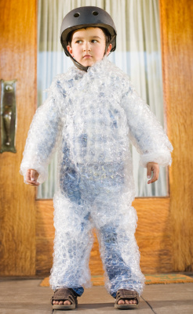

Finding a Balance Between Safety and Exploration

Slide 4
We do need to think about safety
Part of your job as a parent.
Many injuries are preventable.
1 in 10 toddlers visit ER for injury.
  Don’t panic – it’s mostly minor injuries
Notes:
It’s part of your job as a parent.
Many injuries are preventable through: safety-proofing, awareness of hazards, and close supervision.
Despite our best efforts, 1 in 10 toddlers visit the ER for an injury. Unintentional injury: leading cause of death for children age 1 – 4, but don’t panic – chance of death 1 in 10,000
Message wants to convey – we can and should try to prevent injury. No matter how good a job we do, some day our kid will get injured. But generally they’re OK in the long run

Slide 5
What’s the Flip Side?
Kids need to explore to learn.
If parents over-protect, child may never learn safety skills.
Facing some mild risks helps a child learn decision making and build courage / competence.
Coping with a minor injury builds resilience.
Notes:
Children need to independently explore their world to discover and learn.
If parents over-protect, the child’s learning potential is stunted.
Also, facing a few mildly risky situations and experiencing a few mild bumps helps a child understand safety issues.
If parents over-protect, child may never learn safety skills, which puts him at risk.

Slide 6
Safety Proofing: Creating a Safe Environment for Exploration

Slide 7
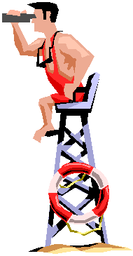
Keys to Safety
Child proofing is a
great idea.
But nothing beats
adult supervision!

Slide 8
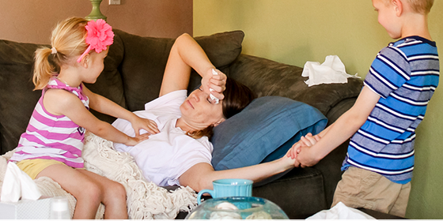
Keys to Safety
Pay extra attention when sick, tired, away from home, or child is in someone else’s care.
Notes:
Risk of injury is greatest in these situations.

Slide 9

Keys to Safety
Learn about child development so you’re always one step ahead.
Ask yourself:
What can my child do now?
What will they do next?
Notes:
Go through this slide quickly – you want to spend more time on the next slide which is that “what do you do to reduce these risks”
t and being aware of your own baby’s abilities and growth will not only help you feel proud of and engage with your baby, but it will also help you recognize potential risks for injury as your child grows. When safety-proofing, you’ll always want to keep in mind what you need to do so things are safe for them NOW, and so you’re ready for the next developmental stage as well. (So, when they learn to roll, you need to be thinking ahead to what you’ll need to do to keep things safe when they begin to crawl.)
Your child’s need for protection and guidance will constantly change, just as your child will.
It’s important to think about things like:
What can my baby do right now?
What can’t she do right now?
What risks could this pose?

Slide 10
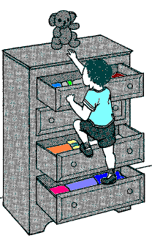
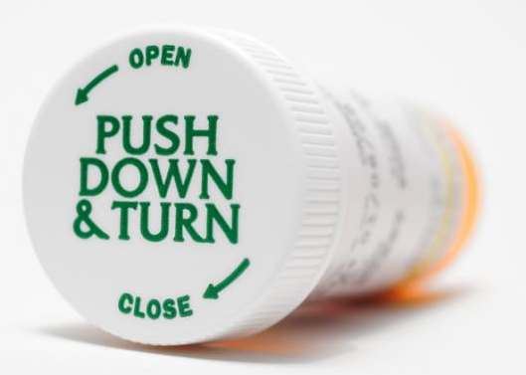
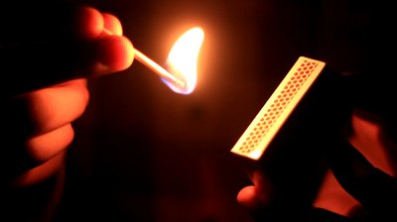
Development & Safety
Large motor skills:
What can they reach?
Small motor skills:
What can they open?
Cognitive: What have they watched you do?
Notes:
Safety issues change as your child grows
Some things that used to be risky are now safe.
Some things that used to be safe are now risky.
Continue to adapt your safety proofing and your limits to child’s new abilities.

Slide 11
Evaluating Risk
When making decisions about
child-proofing
setting limits on behavior
and letting your child explore
it may help to think about different levels of risk.
Notes:
Differentiating level of risk
When deciding what needs to be baby-proofed, and what boundaries to set, think about the level of possible risk involved.
If a situation is potentially life-threatening, baby-proofing and strict rules are essential.
For a situation where the worse that can happen is a bruise or a scrape, then parents may choose not to babyproof, may have more relaxed rules and limits, and may use it as a teaching tool

Slide 12
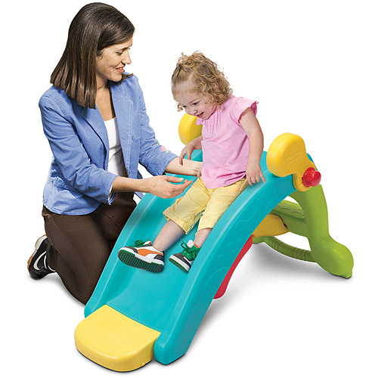
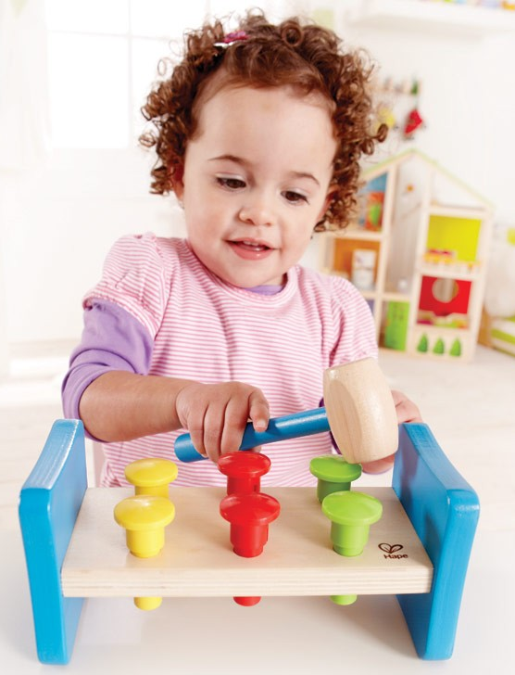
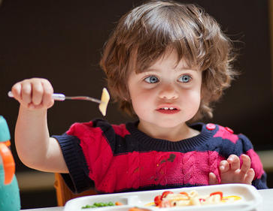
No Risk: Green Light
No real risk of harm
Sit back, relax, let the child explore
Notes:
This part is a quick intro to this idea – we’ll go into more detail later.

Slide 13
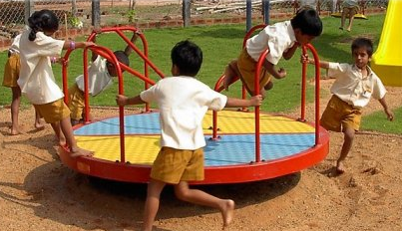
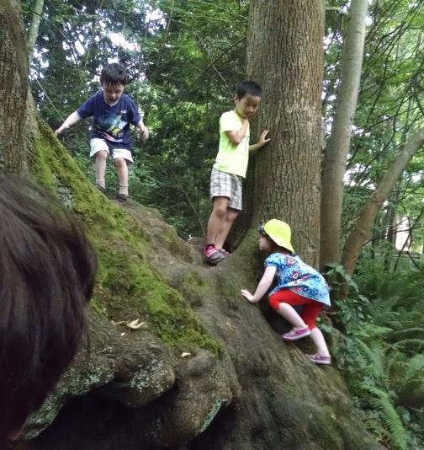
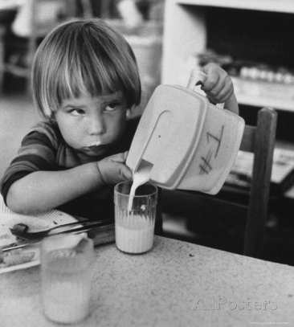
Low Risk: Yellow Light
Could cause
  minor bumps and bruises, or
  minor property damage

Slide 14
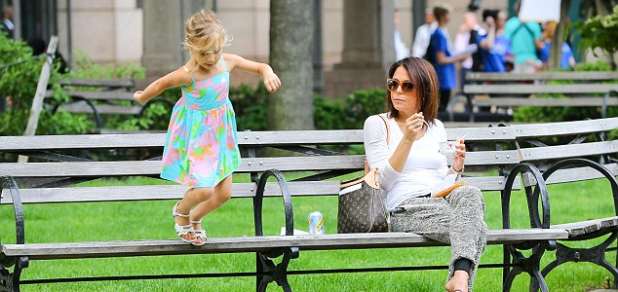
Low Risk: Yellow Light
  Observe your child, intervene as needed.
  Could it be a low-risk learning experience?
Make parenting choices in the moment.

Slide 15
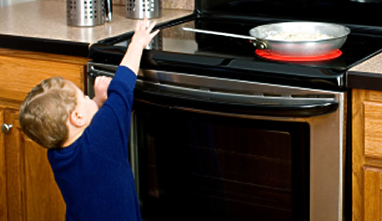
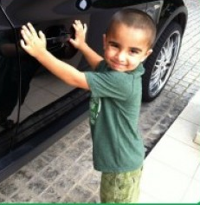
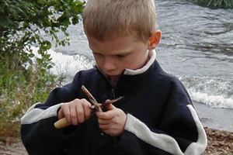
Moderate Risk: Orange
Could be major injury
Let them know it’s a risk. Teach them how to stay safe while you’re supervising
Don’t allow them near these hazards when they’re unsupervised

Slide 16
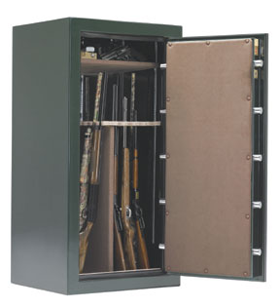
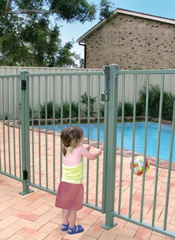

Highest Risk: Red Light
Could become life-threatening in the blink of an eye.
Remove hazards or block them off.

Slide 17
Preventing the
Most Common Childhood Injuries
Notes:
Let’s talk about the orange lights and red lights – what can we do to prevent the most common big injuries?

Slide 18
Most Common Accidents
Death | Injury
Drowning – 32% | Fall – 43%
Motor Vehicle – 27% | Struck By / Against – 18%
Fire / Burn – 12% | Bite / Sting – 7%
Pedestrian – 8.7% | Foreign Body – 6.2%
Suffocation – 8.3% | Cut – 4%
Fall – 2% | Burn – 3%
Poisoning – 1.2% | Poisoning – 2.4%
Firearms – 1% | Motor Vehicle – 2%
Notes:
I don’t usually share this slide with parents, but it’s helpful for me to know this info.

Slide 19
Most Common Accidents for toddlers
Most common cause of injury: falls
  They’re the reason for MOST ER visits
  Orange light / yellow light situations
Chance of death from an accident is VERY small… but when it happens, most common causes: motor vehicle accidents, drowning, fire / burn
These are our red light areas
Notes:
So, we look at what the big risks are, and that’s where we start. (SKIM!!)

Slide 20
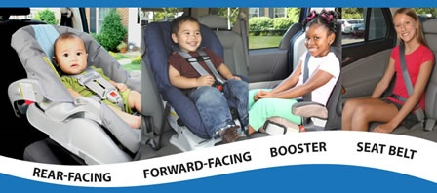
Motor Vehicle Safety
Install correctly
Keep child in each type of seat as long as possible
Don’t leave child alone in the car
Notes:
Most common cause of injury in children is motor vehicle accident. So, we’ll start with motor vehicle safety
Your child will ride in some type of child restraint until they are able to fit properly in a vehicle seat belt, which is generally when they are about 4’9” tall. (Children reach this height sometime between age 9 and age 13)
For the best protection, keep your child in each stage for
as long as possible before moving on to the next.
(as long as they fit in the seat height and weight wise, keep them in it, even if they’re past the typical age for that seat)

Slide 21
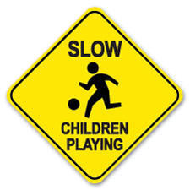
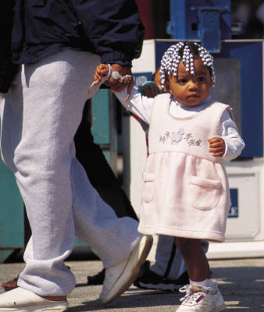
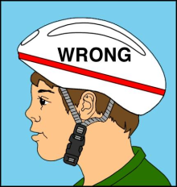
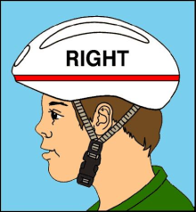
Pedestrian / Bike Safety
Motor Vehicle Safety
Teach caution around cars:
  Don’t play near cars
  Do carry kids or hold hands near cars
  Do model looking both ways
Use bike helmets, teach safe habits
Notes:
Thousands of children are injured each year by being backed over, run over, trapped in cars, attempting to drive, or playing in or around cars.
Half of backover injuries are to children 1-4 years old. Entrapment is especially of concern as children get older and more curious.
Prevention:
Don’t let children play in cars --this includes letting your young child sit in your lap or “play driver” in the car and letting your child play around unbelted in the back seat – even while the car is sitting still in a parking lot
Don’t let children play in parking lots or driveways – we want to set up the expectation that cars are not to be played around because they can move unexpectedly (or the unpredictable delivery truck can pull up in your driveway when least expected)
Always carry your child or hold your child’s hand on sidewalks, driveways, or in parking lots. Be absolute about this rule… no exceptions
Escort child in and out of car – don’t let children open doors or climb in/out of cars unless you are standing RIGHT there.
Walk all the way around your vehicle before getting in and check mirrors
Teach and model safe pedestrian habits, from early on! Use consistent language. (stop, look left, look right, look left, no cars coming, safe to cross!)
CAR SEATS OUTSIDE CAR:
Each year, 10,000 infants are brought to the ER for injuries received while in the car seat outside of the vehicle.
The majority of these injuries were to the head and neck and 85% were from falling - either the child falling from the car seat or the car seat falling and the child hitting something.
Note:
Reason not to listen to old wives’ tale about putting car seat on the washing machine to soothe
Potential dangers:
using on top of high chairs, strollers, shopping carts, counters, restaurant booths, tables, beds, sofas, etc.
*most car seats do not permit use on top of shopping carts. Better to use other option (like a carrier or stroller) or put car seat in large part of shopping cart

Slide 22
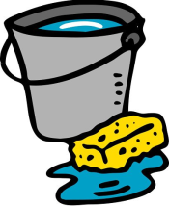
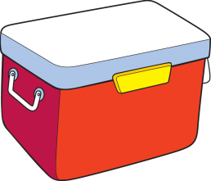
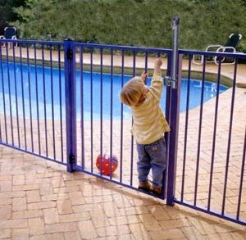
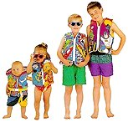
Water Safety / Drowning Prevention
Never leave a child alone near water! (Even 2 inches!)
  Near lakes, rivers, and boats: flotation devices
  Do take swim lessons… but
    Remember swimming lessons do not “drown proof”
Notes:
When we talk drowning prevention, we’re not just talking about swimming pools and lakes. We also mean protecting your kids in the bath tub and from unexpected drowning risks like toilets, coolers full of melted ice, and buckets.

Slide 23
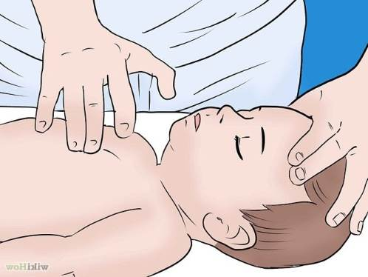
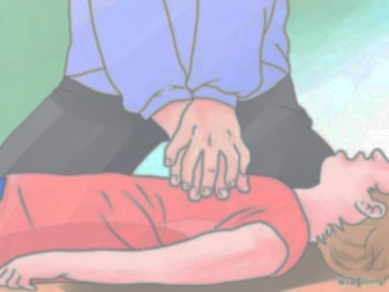
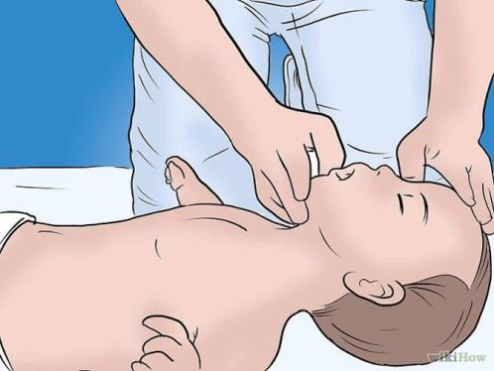
What to do if Drowning Occurs
Perform CPR if child is not
coughing, breathing, or moving.
Call 911 (if alone, CPR
for 2 minutes, then call)
30 compressions
Airway, 2 breaths
Repeat till child recovers
Illustration: wikihow
Notes:
*** each of the steps flies in for emphasis. Do one at a time ***
Say- we’ll talk more about and practice CPR later in class, but this is a brief overview
ABC’s stands for Airway, Breathing, and Circulation.
Airway reminds us to check if their airway is clear, and ensure that they are in a position where it’s easy for them to breathe. Breathing reminds us to check for breathing: watch their chest to see if it is rising and falling. Circulation reminds us to determine if they have circulation. We used to recommend that people check for pulse, but it may be hard for laypeople to quickly find the pulse, so for now, to watch for circulation, let’s just think about: is child coughing, breathing, or moving?
If not, check for pulse. If it is easy to find the pulse, do rescue breathing.
If you can’t find a pulse, or are unsure about the pulse—go ahead and begin CPR
In case of drowning, watch out for vomiting—victim is likely to have swallowed large amounts of H₂O.
Turn head, clear mouth and resume CPR
Do not try to remove water from lungs.
Do not give up: Hypothermia and the diving reflex (causes blood to shunt from fingers toes etc to vital organs when submersion occurs) lead to survival even with long submersion.

Slide 24

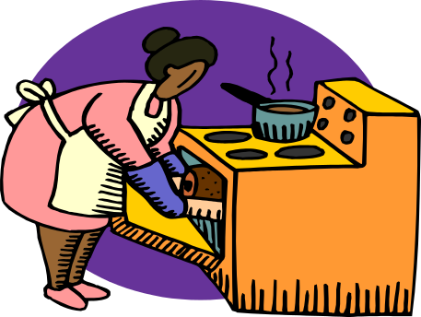


Burn Prevention
Fire prevention
Smoke detectors & fire extinguishers
Escape plan
Hot!
Prevent contact burns
(stove, campfire,
hot drinks, etc.)
Notes:
Never smoke inside
Matches out of sight & reach
Smoke / carbon monoxide detectors
Fire extinguishers
Gate wood stoves, heaters,
use screens on fireplace
Don’t hold child while cooking, eating hot foods, or drinking hot drinks
Use back burners – pot handles pointing in
Water heater temp down to 120° F
Outlet covers, cords out of child’s reach

Slide 25
What Can You Do If Your Child is Burned?
Burn Treatment
Apply cool water for several minutes
Keep the burn area clean
Notes:
Call 911 if there’s a burn larger than child’s hand print, or severe burns on hands, face, or genitals.

Slide 26
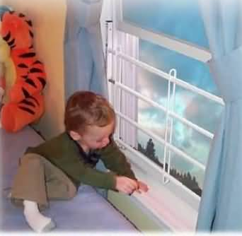
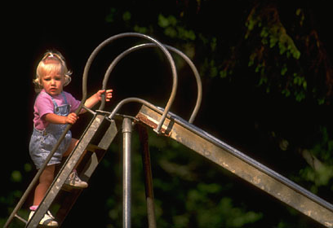
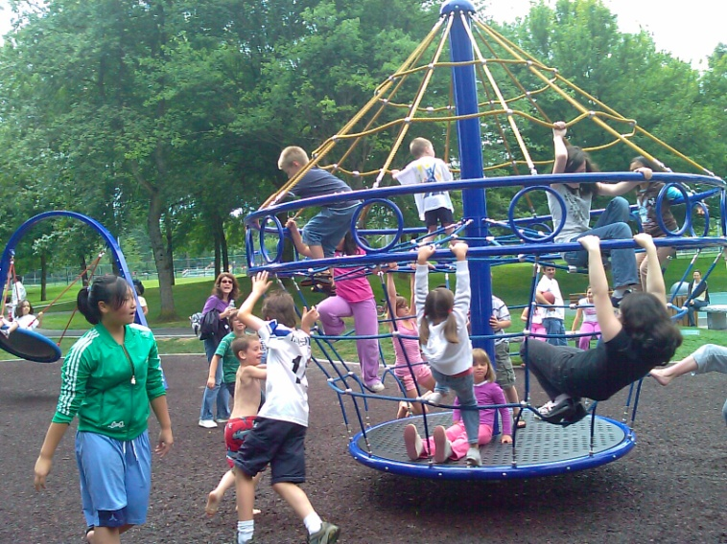
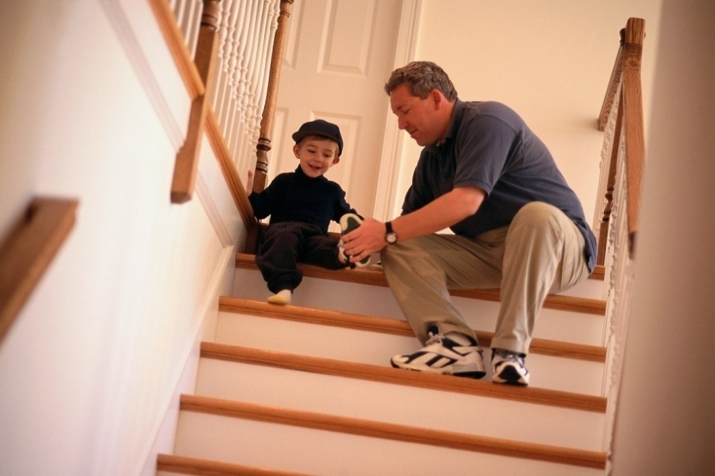
Fall Prevention
Notes:
Playground: teach safe behavior, supervise
Stairs: Teach safe stair use
Avoid climbable furniture near windows; use window guards; check balcony railings
Don’t allow child to climb on furniture
Don’t put objects of desire on high shelves.

Slide 27
Fall Prevention
  Playground: teach safe behavior, supervise
  Stairs: Teach safe stair use
  Avoid climbable furniture near windows; use window guards; check balcony railings
  Don’t allow child to climb on furniture
  Don’t put objects of desire on high shelves.
Notes:
Approximately 60% of unintentional nonfatal injuries seen in the ER in children under 1 year old are from falls.
Securing Furniture: earthquake retrofit kits work well. Also secure TVs or anything else that is heavy and freestanding that child could pull up on.
Window guards: make sure they’re easy to open in case of fire. Window locks are another option.
When baby can climb: Don’t put toys and interesting objects in places baby could climb to reach. They may tempt baby to climb.
Strap down furniture (bookcases) so they don’t tip over when baby climbs, or in earthquake. Strap down TV so baby can’t pull it over on himself.
Use baby gates on stairs, and always remember to close them!! (Most dangerous situation is when a baby is used to there being a baby gate, and one day discovers that it’s open, and decides to explore this new situation.
Install window guards or window locks - Never depend on screens to keep children from falling out of windows.
Check to be certain deck railing meet code (can’t fit a coke can between the railings)
Model Safe Behavior
Do not climb to reach things in front of your child
Use hand rails and do not skip steps on the stairs
Do not store, move, or hide items of interest on raised surfaces

Slide 28
Treating Minor Cuts & Bruises
Bumps and bruises: If turning red or swelling, apply ice for 20 minutes to relieve pain and reduce swelling.
Bleeding: wash well with soap & water. Apply pressure to stop bleeding. Bandage, keep clean & monitor for signs of infection.
Notes:
No matter what you do to prevent falls, there will be times where your child falls and is bruised, or falls and cuts himself.
Severe falls – if child not moving or loses consciousness, don’t move – assess first; do CPR if needed; call 9-11 if needed
Bleeding – if hasn’t stopped bleeding after 10 minutes of pressure and has two edges you can’t keep together, need stitches.
For Bleeding: if it hasn’t stopped within ten minutes of applying pressure, call doctor. If edges of cut are jagged, and can’t be brought together, stitches may be necessary.
Ice packs: don’t apply ice directly to bare skin, as this can damage tissue. Wrap in a washcloth or cloth napkin. Many parents keep a special ice pack in the freezer for bruises: they may wrap it in a special washcloth, or have a boo-boo bunny shaped cloth or some such thing which could reassure a hurting child.
Have them take our the red book on treating childhood emergencies and illnesses.
Have them turn to the table of contents and review briefly what information is covered in the booklet.

Slide 29

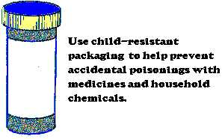
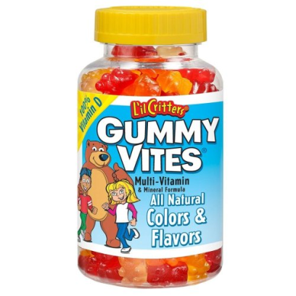
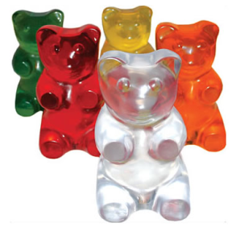
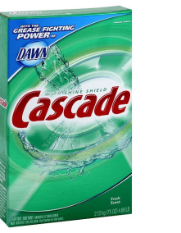

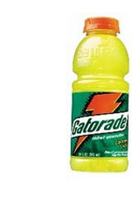
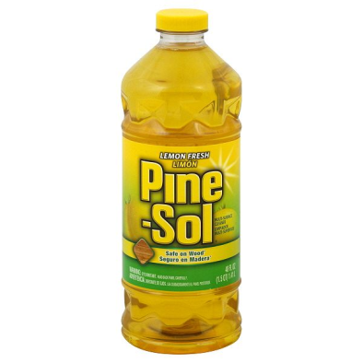
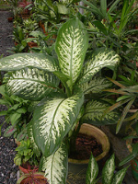
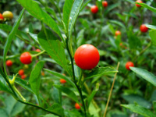
Poisoning Prevention
Notes:
Demonstrate look-a-likes—medicine and candy. PASS THEM AROUND.
Have them brainstorm most common poisonous substances found in homes.
May include acetaminophen (tylenol), aspirin, antidepressants, pesticides, vitamins and minerals (especially fat-soluble vitamins and iron), houseplants and outdoor plants (especially berries), and household cleaners and chemicals.
If they do not suggest some of these, bring them up.
Discuss look-a-like products such as lemon oil polish and apple juice; antifreeze and gatorade.
POINT OUT POISONING FACT SHEET IN PACKET

Slide 30

Prevention
Poisoning Prevention
Get rid of things you don’t use!
Store products out of sight
and reach. Lock up?
Use “Mr. Yuk” stickers.
Teach child to ask before eating
Notes:
Call the poison hotline for Mr. Yuk stickers.
Go through your house now.
Anything you don’t need, get rid of!!! Properly dispose of any potential poisons and toxins
Anything you don’t use regularly: Put it in the garage, or laundry room, or somewhere else your child will rarely go.
Tings you use regularly, like dishwasher detergent: put them up high out of baby’s sight and out of baby’s reach.
In addition to moving poisonous substances out of baby’s reach, also put stickers on all of them, also teach your child what the sticker means. That way, even if your child does eventually get into the place where you store these items, they are aware that they are dangerous. Under age 3, children may not recognize Mr Yuk but begin training early
Watch out for repeat offenders

Slide 31
If Poisoning is Suspected
Call Poison Control 1-800-222-1222
Don’t give water, induce vomiting, or do anything else unless / until Poison Control says to.
Call 9-1-1 if recommended.
Notes:
Put poison control number in your phone!!
DO NOT CALL DOCTOR FIRST – Call Poison Control Center! The PCC will refer you back to your Heath care provider when appropriate. Have the phone number posted near your phone!
Ipecac:
The American Academy of Pediatrics recommends that syrup of ipecac no longer be used in the home to treat poisoning.
However, the Washington State Poison Control Center advises parents to keep syrup of ipecac on hand to treat poisoning (but only use it when you are told to do so by the Poison Center or your doctor).
You can trying calling poison control now. Practice listening to message, so you’re familiar with the process in case of emergency.

Slide 32
Expect they will choke and learn what to do!
Choking Prevention
Provide age-appropriate toys & food
Keep small objects away when unsupervised
Teach them how to handle when supervised
No walking or playing while eating
Notes:
Any kind of packaging, decorations, or pieces of toys, food, or other household objects can pose choking hazards.
This includes things on the floor that most adults don’t notice (rubber bands, earrings, coins, etc.) and also older children’s toys.
cut food into Bite-size pieces that are easy to chew and swallow, nothing too tough or too chewy.
Not allowing children to move around while eating, and limiting what level of playing, talking, and singing is done while eating will help prevent choking.
(Fly in TP Tube) – REMEMBER, if it fits through a TP tube, it’s too small!
Small parts – large pieces - mushy things – hard things – thick things – thin things = they can all be choked on!

Slide 33
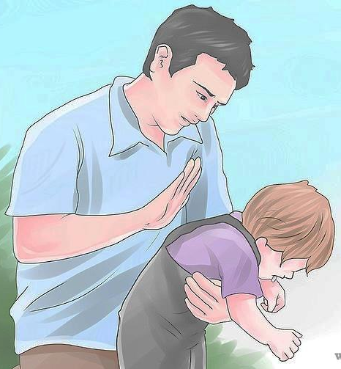
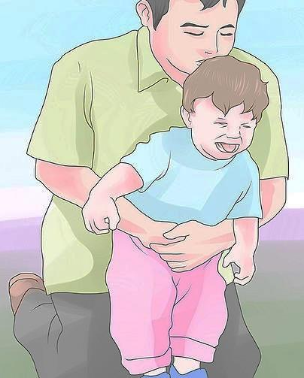
If child appears to be choking
Assess: Can child talk, cry, or breathe?
If so, do nothing.
If not: alternate back blows and chest thrusts.
Continue until object is out and child is breathing well,
If child stops breathing:
Call 911. CPR.
Notes:
*** each step flies in ***
If coughing to clear airway, do not pat back
Demo how to support jaw neck and head. Make sure they’re comfortable with this holding position before moving on to back blows (Demo how to lock baby against your side with leg under your elbow so you don’t drop him!)
Demo
Practice time

Slide 34
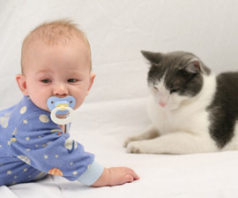
Safety around Animals
Train your pet
Teach your child how to:
be gentle
respect an animal’s space
not mess with animal’s food
Never touch without asking
Supervise! NO animal can be trusted alone with a young child
Notes:
No matter how gentle the dog or cat, or how well you think you know the animal, remember that it is still an animal, and if sufficiently provoked, animals will attack. Always supervise your child around animals!
You can train your pet appropriate behavior. Dogs should be able to follow commands like “Sit. Down. Leave (as in leave that alone!)” Cats can be trained to go away when you hiss at them.
You can use baby gates or other devices to keep animals and baby separate
Be especially aware around feeding time – animals can get very territorial / defensive if a child comes near their food. If you used to have food down for your pet at all times, you may want to switch to planned meal times when the child is not around
You can model for your child how to gently pet an animal and not pull on its ears or tail
How to respect an animals’ space (like not walking up behind horses, or backing any animal into a corner)
To leave animals’ food alone
To never touch an unknown animal without first getting the explicit permission of its owner

Slide 35
Teaching Safety Skills

Slide 36
Teaching Safety Skills
Prepare, don’t scare.
Teach how to be careful.
Practice skills under supervision.
Play games, but make sure you’re clear when it’s not a game.
Honor the child’s instincts.
Say no to unsafe behavior.
Notes:
Research shows if you express your fears when telling your child about potential dangers, she won't remember your message, only that you were scared. Practice using moderate language and a matter-of-fact tone when you discuss sensitive issues. Focus on what your child needs to learn, rather than why it upsets you. Share your fears and worries with other adults, not your children.
Show your child how to be gentle and how to be careful. Talk to him about situations where you’re feeling worried about your safety or his, and how you back out of those situations.
Practice things with lots of support. (For example, you may need to sit on the stairs and go up and down and up and down with her several times while she learns the skill so that eventually she can do it on her own.)
Play games like “Red Light Green Light” that let him practice stopping on command. But also let him know that if you ever shout “Stop” that’s not just a game and it’s an absolute “Red Light. Don’t move till I tell you it’s safe.”
If your child is feeling worried and unsafe, don’t just say “There’s no need to worry.” Say “I can see that you’re worried, and this looks unsafe to you. But I know it can be safe for you – let me show you what to do to make it safe.”

Slide 37
Talking about Safety
Go for it!
Have fun!.
Careful…
Fragile...
Gentle……
Danger!!
Hot!
Slow Down!
STOP!!
Ouch!
Hands off!
Notes:
Safety Words
As babies start learning language, you can start using safety words. Use the word, then model what behavior you want them to do.
Some words are gentle suggestions... Say “careful” when they should slow down and pay more attention. When you say ‘fragile’ or ‘gentle’, model for them how they should handle that object so nothing gets hurt
Some words indicate they need to change their behavior to be safe: If you say “hot” show how you pull your hand away from it. If you say “ouch” show how you would move away from that thing so as not to get hurt by it.
Save “danger” and “stop” for when you really mean it. When you say them, use a strong voice followed by immediate action. If you say danger, then you need to remove them from the situation, or remove the danger from the situation. If you say stop, they need to stop, or you will remove them from the situation.
It’s a long time before they will actually understand these words and these consequences, but if you start using them consistently now it will help them learn these words and behaviors earlier.
Try to avoid just saying “no” all the time, as it doesn’t help your child learn appropriate behavior and it’s not specific to the child what you’re referring to, even if you think it is. Try using action-words. Describe things to tell your child what to expect or tell them what to do. Kids hear verbs and adjectives much more than they hear “no” or “don’t”. (In other words, if you say “don’t throw” they hear throw. If you say “set that down gently” they will.)
Family Plan this is another example of how having a family plan is helpful, because this sort of language will be most powerful if all caregivers use the same words consistently. There can be some flexibility between situations and caregivers as far as how far into the yellow or orange before stopping the child, but overall having consistency in the words you use will help your child learn their range of safety.
If you find you’re continuously using these safety words every time baby moves, either you might need to relax a little bit… or you may need to safety proof the environment more so your child can explore without arousing your fears.

Slide 38
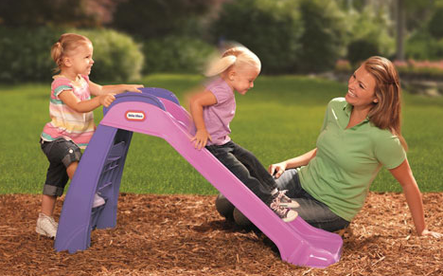
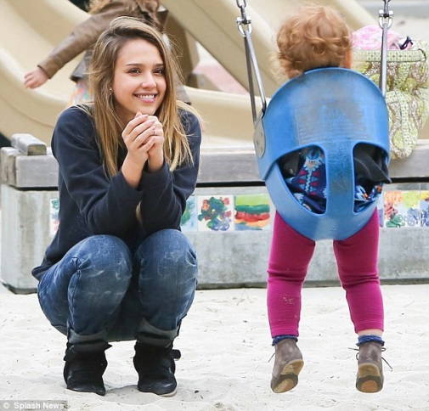
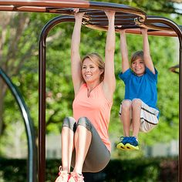
No Risk: Green Light
Body language, expression and words all say: “It’s safe. Go play!”
Have fun!.
Go for it!

Slide 39
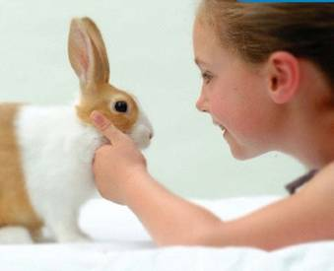

Low Risk: Yellow Light
Look positive but thoughtful
Lean forward to show you’re paying attention
Calmly suggest what to do to be safe
Careful of the edge…
Gentle touch…
Slow down…
Be careful not to spill…

Slide 40

Moderate Risk: Orange
Look concerned (not scared) and attentive.
Stand up and move closer.
Use a strong voice to say what the risk is and what they need to do.
It’s not safe to run in the parking lot. I need you to hold my hand.
The oven is hot. Move over there.
That would be a big fall. Go that way instead.

Slide 41

Highest Risk: Red Light
Rules are non-negotiable, and must be followed every time.
Loud, simple, specific commands
Explain later when they’re safe
STOP!!
Danger!!
Notes:
Differentiating level of risk
When deciding what needs to be baby-proofed, and what boundaries to set, think about the level of possible risk involved.
If a situation is potentially life-threatening, baby-proofing and strict rules are essential.
For a situation where the worse that can happen is a bruise or a scrape, then parents may choose not to babyproof, may have more relaxed rules and limits, and may use it as a teaching tool

Slide 42


Finding a Balance Between Safety & Exploration
Notes:
So, risky play is fun. And kids learn important things through this exploration, but how do we keep them safe
Finding a balance…

Slide 43
Benefits of Risk in Children’s Play

Slide 44

Benefits of Risk in Children’s Play
Notes:
Download the video on Benefits of Risk in children’s Play. https://www.youtube.com/watch?v=Lbev391A3nE&t=180s&pp=ygUjYmVuZWZpdHMgb2YgcmlzayBpbiBjaGlsZHJlbidzIHBsYXk%3D
Insert it here, and play from:
:14 – 2:27

Slide 45
Kids’ Favorite Risky Games
Great Heights
Rapid Speeds
Dangerous Tools / Elements
Rough & Tumble Play
Disappearing / Getting Lost
How do you indulge these desires while still keeping your child safe?

Slide 46

Kids’ Favorite Risks
Great Heights
Notes:
Talk about ways they can let the child take reasonable risks in each area, while still giving them the skills for how to stay safe while doing this.

Slide 47

Kids’ Favorite Risks
Rapid Speeds

Slide 48

Kids’ Favorite Risks
Dangerous Tools / Elements

Slide 49

Kids’ Favorite Risky Games
Rough & Tumble Play

Slide 50


Kids’ Favorite Risky Games
Disappearing / Getting Lost

Slide 51
Kids’ Favorite Risky Games
Great Heights
Rapid Speeds
Dangerous Tools / Elements
Rough & Tumble Play
Disappearing / Getting Lost
How do you indulge these desires while still keeping your child safe?

Slide 52
In case of Emergency, call 9-1-1
Community Resources
Consumer Product Safety Commission (CPSC) www.cpsc.gov | WA Poison Center 1-800-222-1222
Seattle Children’s website www.seattlechildrens.org/safety-wellness/ | SafeKids USA www.safekids.org
WA Safety Restraint Coalition 1-800-BUCKLUP; 800bucklup.org | WA Toxics Coalition watoxics.org
Public Health – Seattle/King County 206-296-4600 www.kingcounty.gov/health | Great Starts (CPR class) 206-789-0833 www.greatstarts.org
Notes:
*** Numbers fly in one at a time: slide one in and explain, then move on ***
Refer to yellow handout: emergency information card. All numbers there
Enhanced 911 in King County and all metro areas & most rural areas.
Stay on line to tell them what the problem is
Better to use home phone (“land line”) versus cell phone
Don’t be surprised to see a fire engine instead of an ambulance
Poison Control Center - National 800-222-1222
In case of emergency, first phone 9-1-1. Once they are on their way, call Poison Control
Call anytime with questions. Can order Mr. Yuk stickers and information about poisonous plants from them
Children’s Hospital Resource Line—Staffed 7 AM to 11PM by RNs
Triage Illnesses & Injuries
Answer developmental questions/ sleep questions / toilet training questions
Can provide resources within & without Children’s Hospital
Great Starts: Childbirth preparation classes, Newborn Care and Breastfeeding Classes
Consumer Product Safety Commission— Info about product safety and recalls. Offers mailing list for recalls.
Wash Safety Restraint Coalition Car seat safety info and class referral
800-BUCKLUP www.bucklup.org Resource for car seat questions (installation, use, special needs), WA child restraint laws, and a list of car seat checkup events and classes in your area.
PHSKC—Public Health Seattle King County
www.kingcounty.gov/health --provide low cost immunizations, information about lead hazards, asbestos, air quality, water quality.
WA Toxics Coalition – resource for environmental health promotion (allergens, toxins, etc. in toys, home products, clothes, etc.) with resources on child safety and health (offers mailing list – Growing Up Green).
Safe Kids USA – part of SafeKids Worldwide – experts on childhood injury prevention from birth through adulthood. Fact sheets on all kinds of child injury prevention topics (bikes, cars, water sports, falls, fires, etc.) and research reports on childhood injury.

